Slide 1

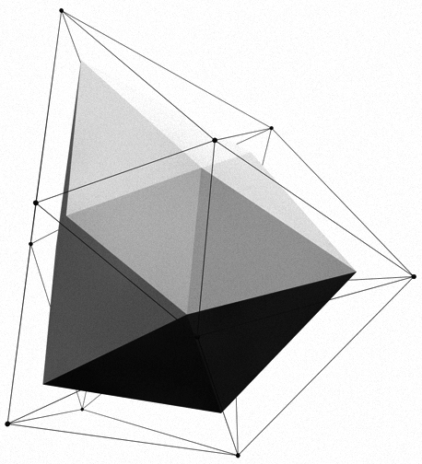


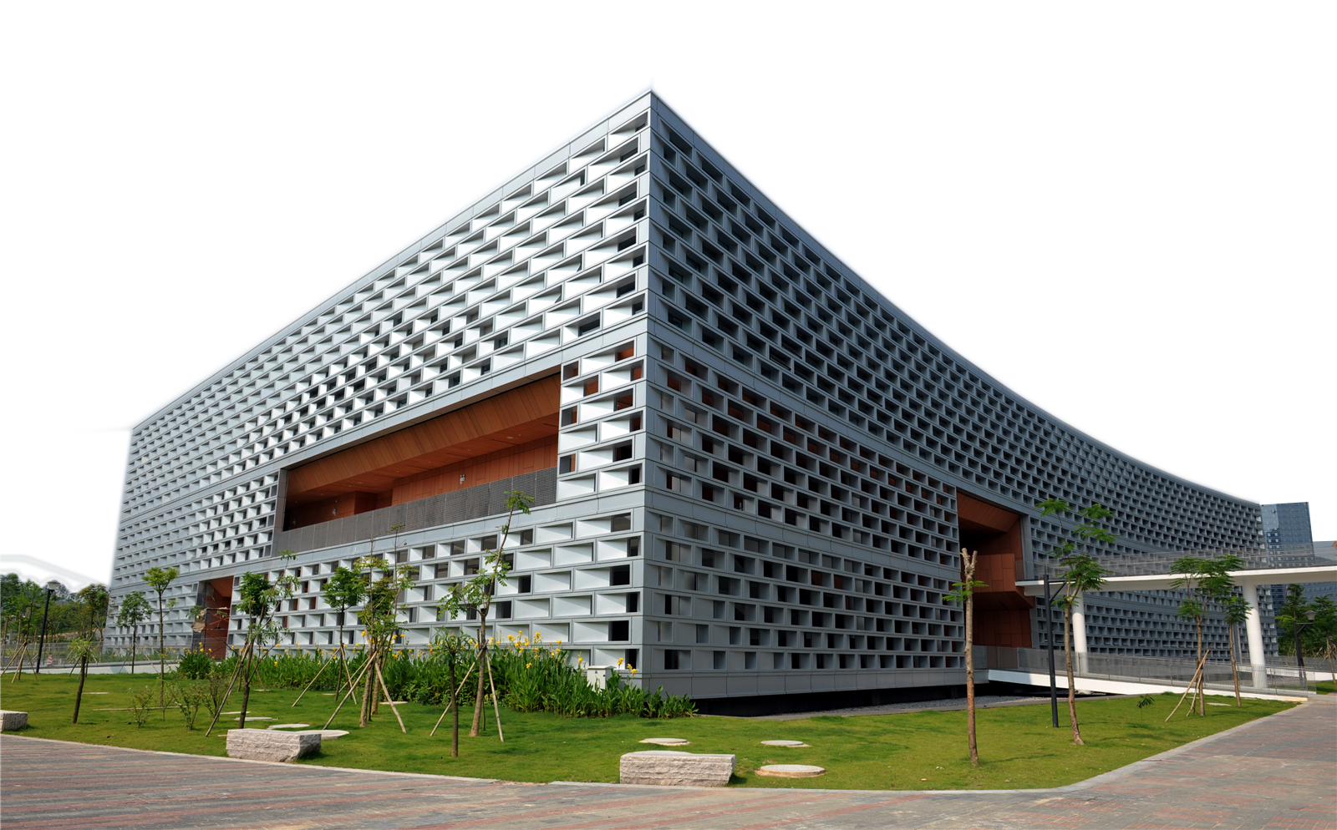
SUSTechMajiang
卞证 向昕昊 徐天元 林傲 孙斌贤

Slide 2

Timeline
preparatory phase:
(before the opening report 2019.10.9)
game rule
Art materials
learn APIs
1
prophase:
(before 11.21)
2
Implement the game logic
so that the whole game can run.
anaphase:
(before 12.21）
3
Testing and maintaining

Slide 3
Let’s first enjoy the game!

Slide 4
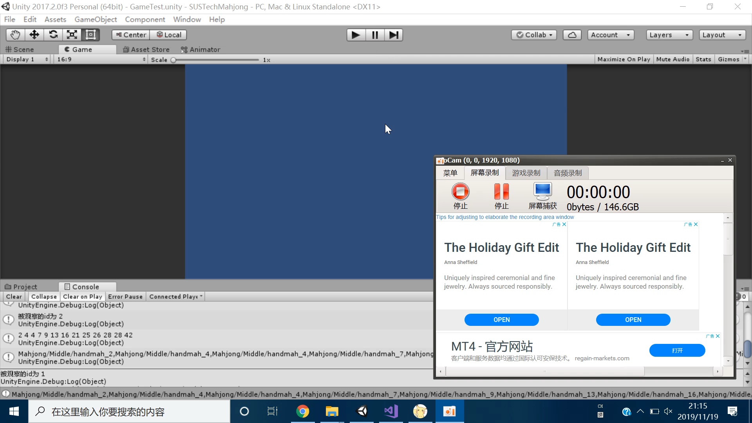
数

Slide 5
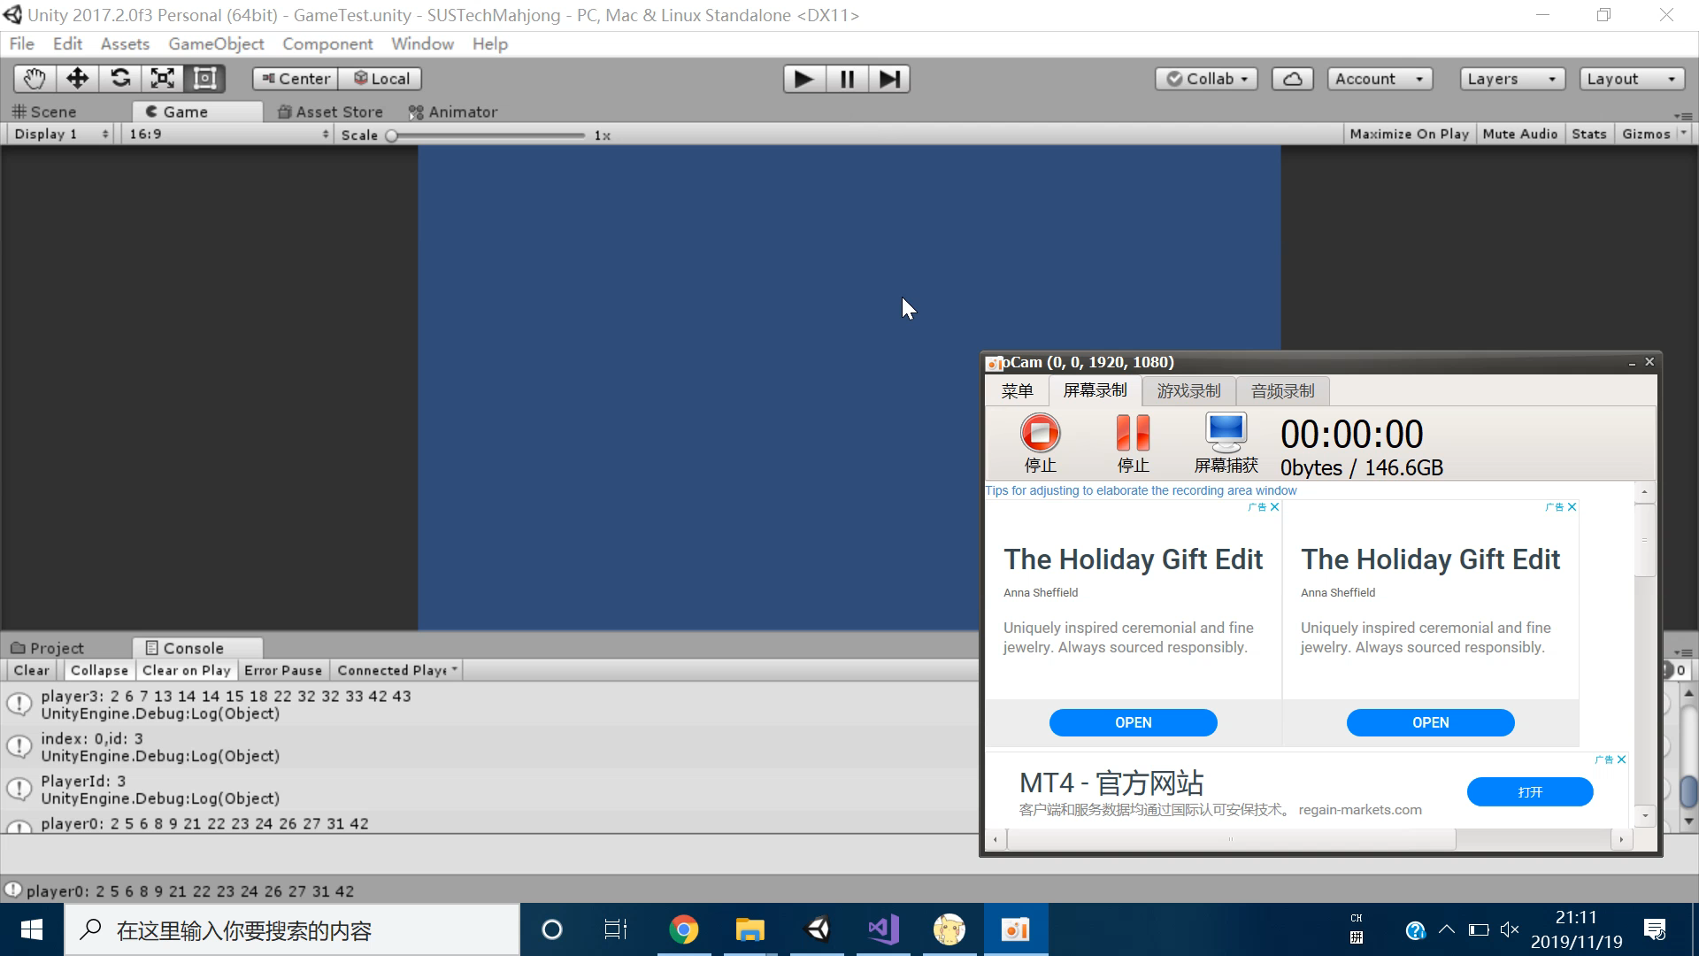
化

Slide 6
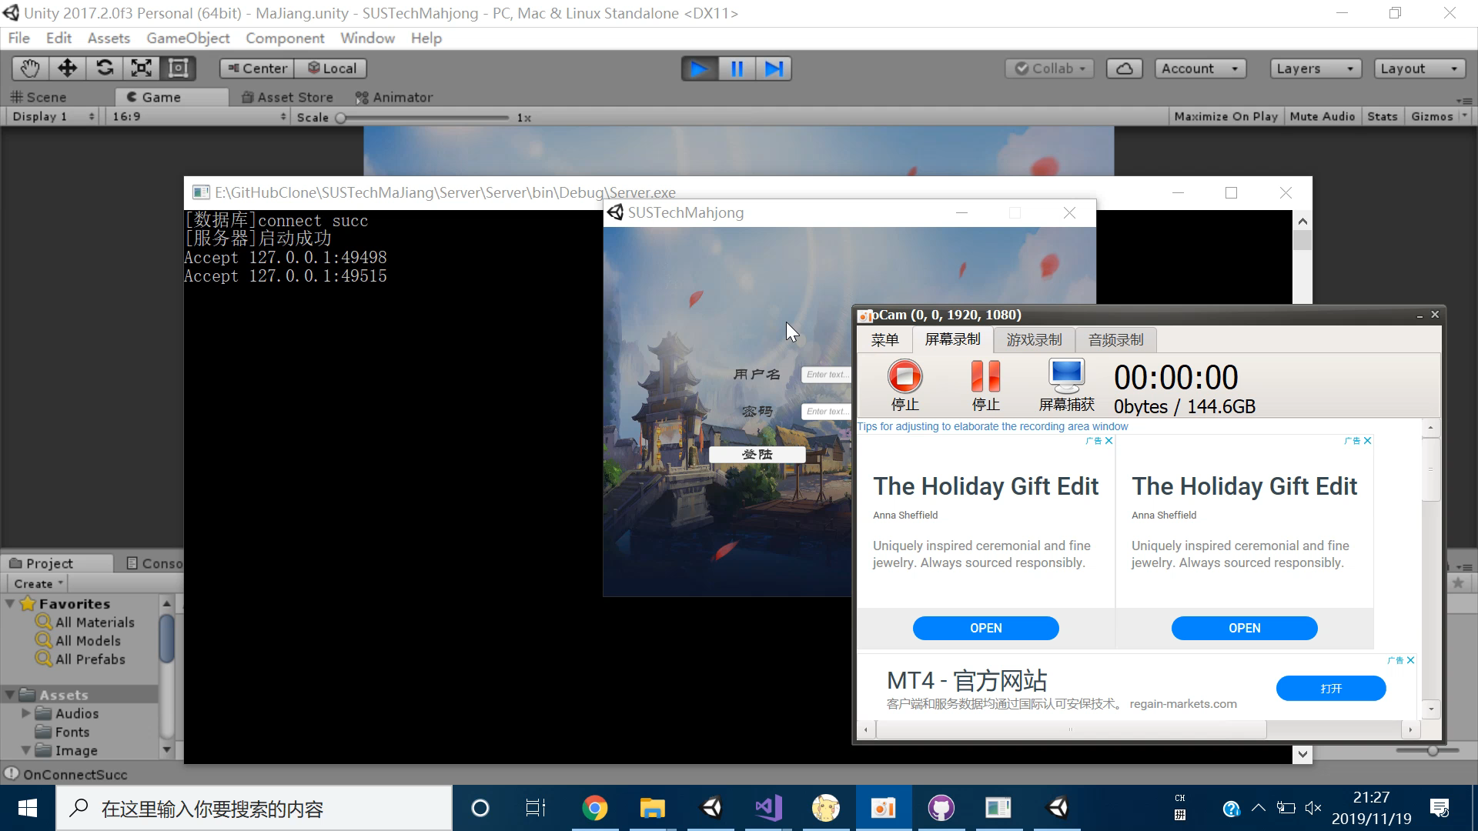
玩

Slide 7
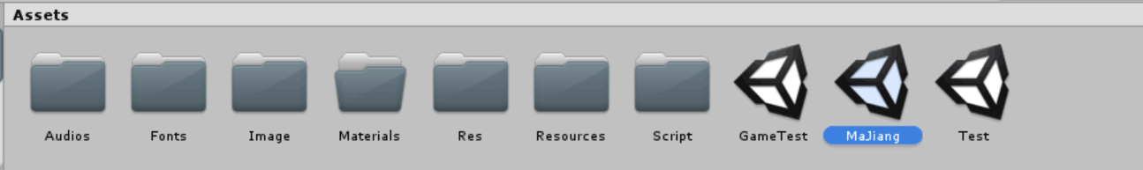
Main things we have done
Implemented the rule logic in the code
Designed a unique Majiang rule for SUSTech
Found more art and music material

Slide 8
1. Implemented the rule logic in the code

Slide 9
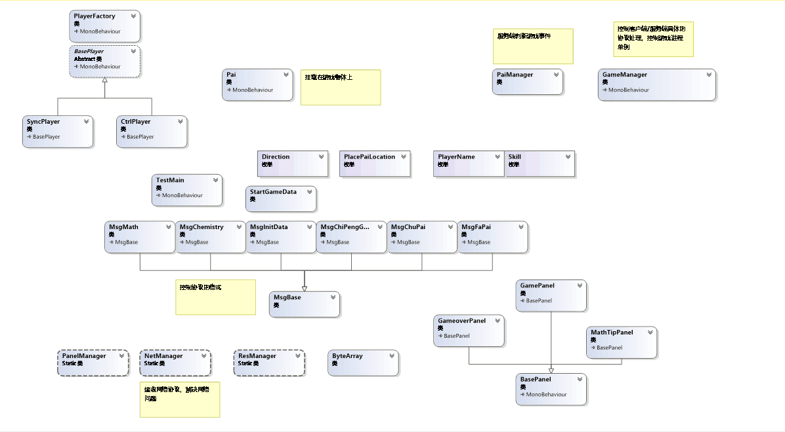
The class diagram generated based on the real code

Slide 10
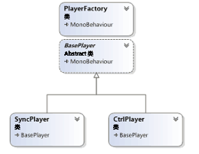
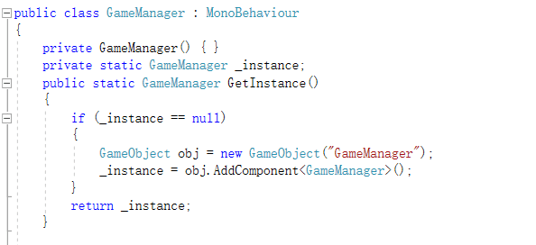
The design patterns we use
Factory pattern
Singleton Pattern

Slide 11
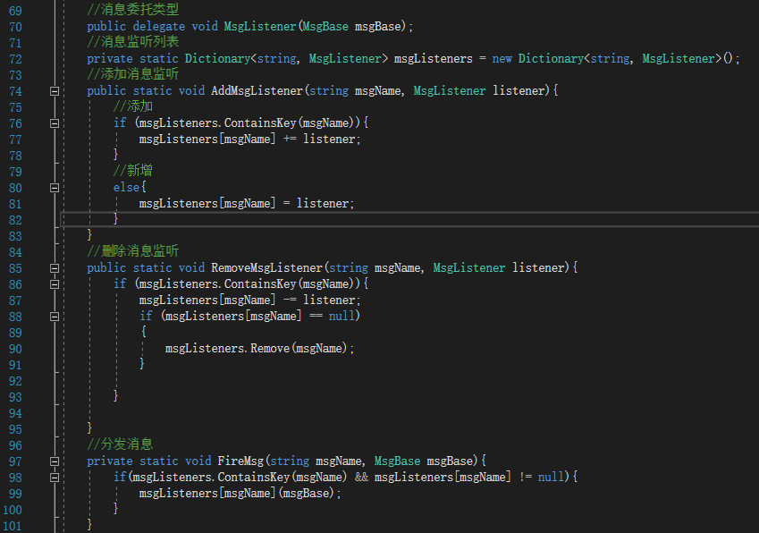
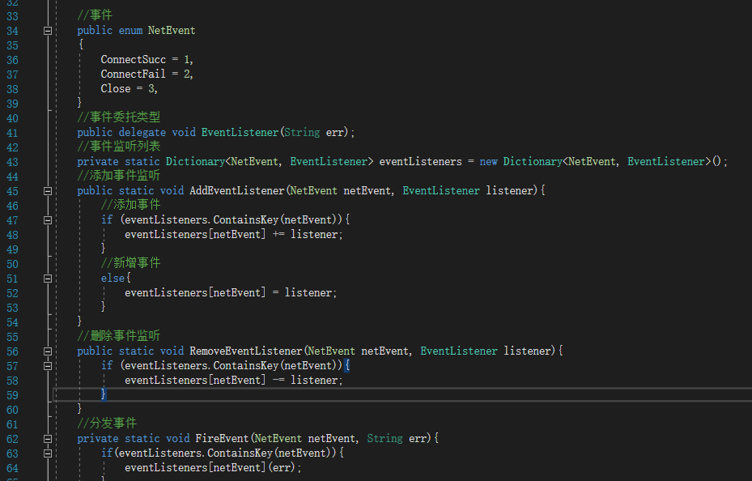
Observer Pattern

Slide 12
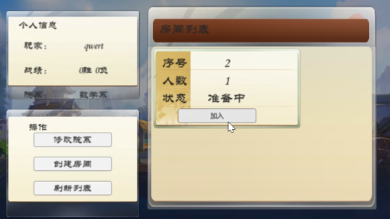
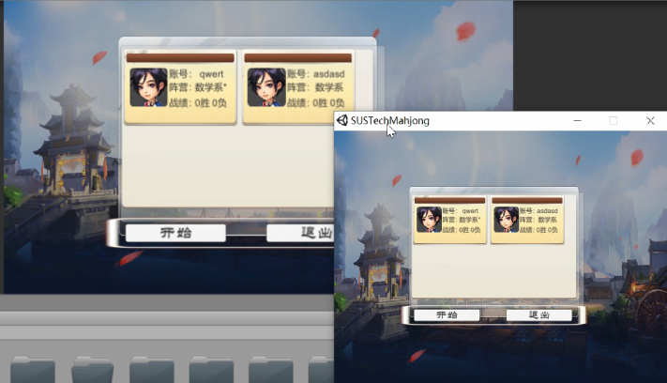
Established the whole network framework

Slide 13
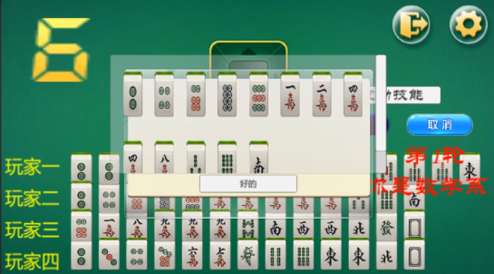
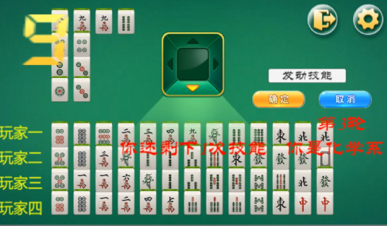
2. Designed a unique Majiang rule for SUSTech
Department skills:
Department of Math:
The number of cards we can see = 14-x (number of rounds)
Department of Chemistry：
Throw one more card and take one more card

Slide 14
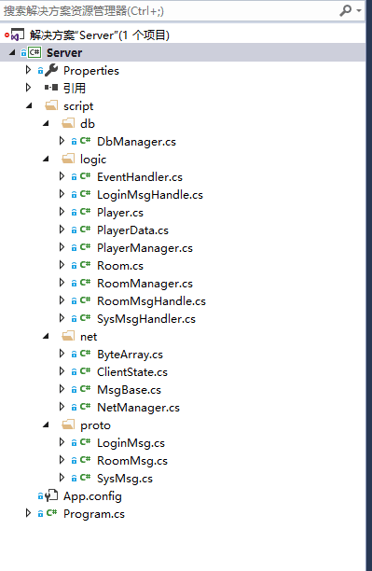
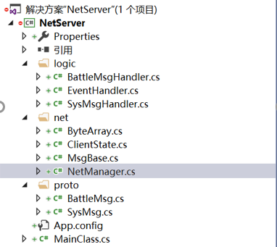
Summary: A glimpse of the works we have done
For the code of the server-side:
Works done by Opening report
Works done by Midterm report

Slide 15
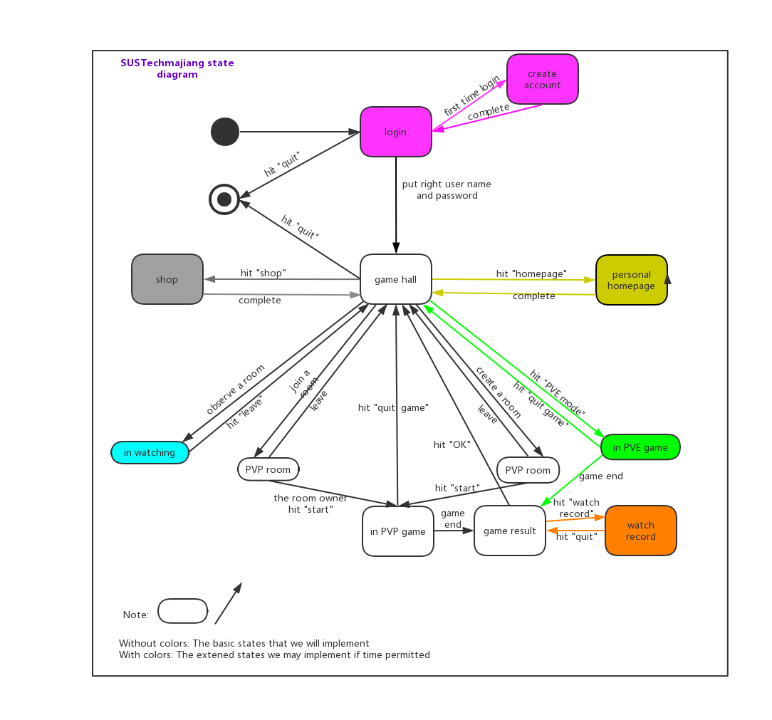
Works we want to do in opening report

Slide 16
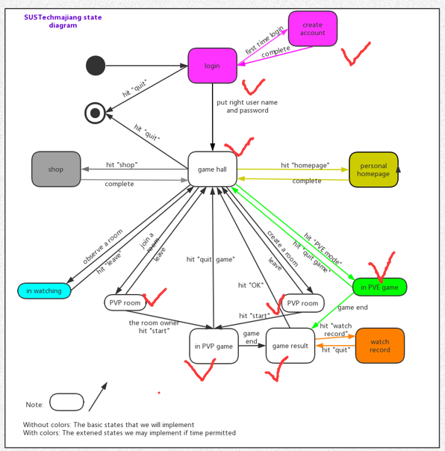
New function:
SUSTech special skills
Works done by Midterm report

Slide 17
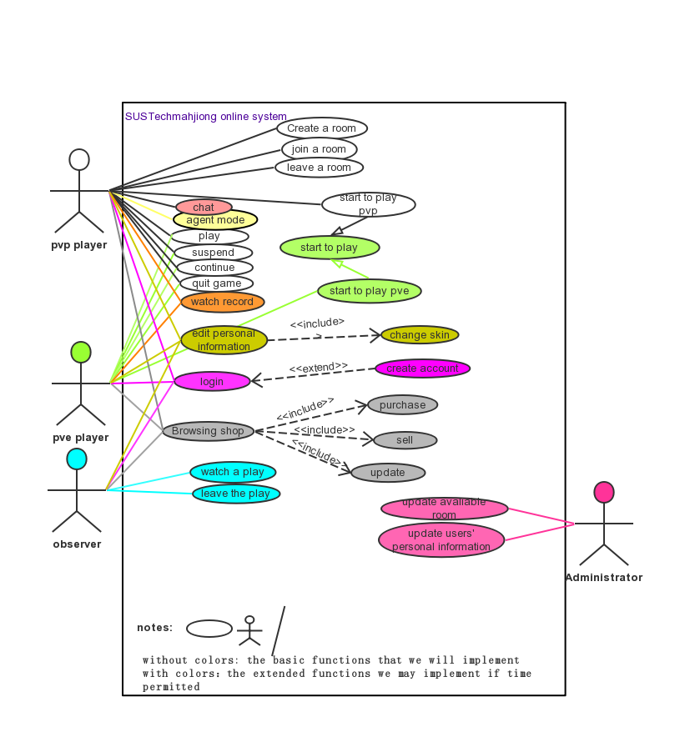
Works we want to do in opening report

Slide 18
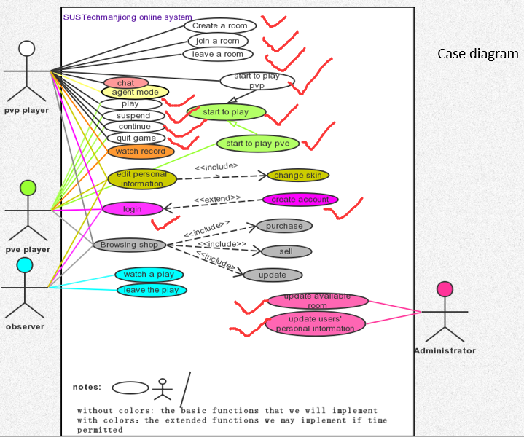
New function:
SUSTech special skills
Works done by Midterm report

Slide 19
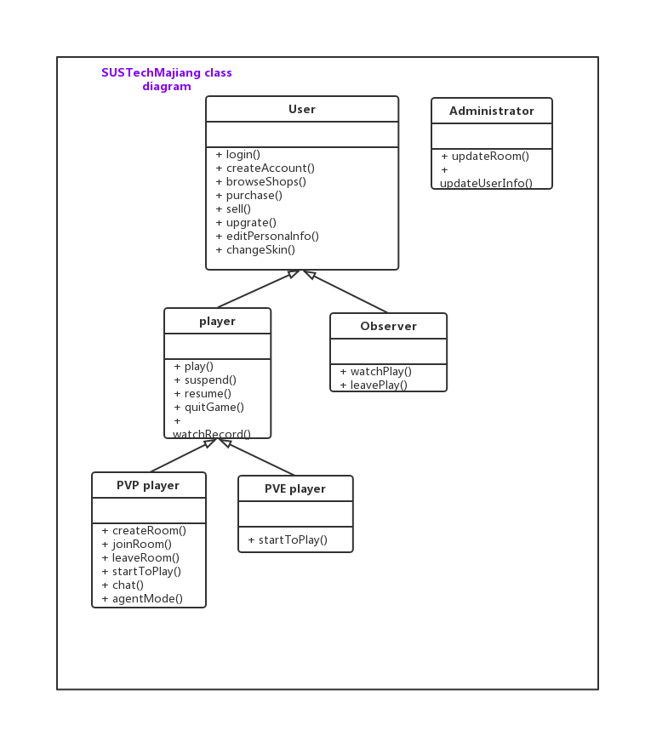

Works we want to do in opening report

Slide 20

Works done by Midterm report

Slide 21
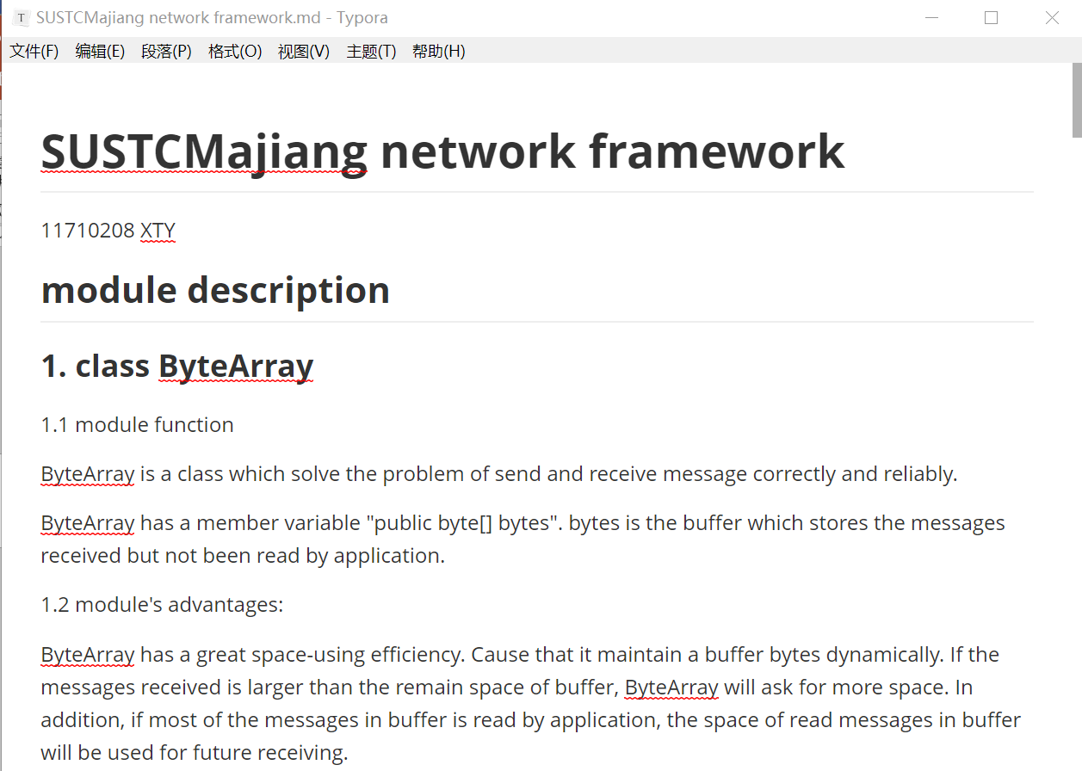
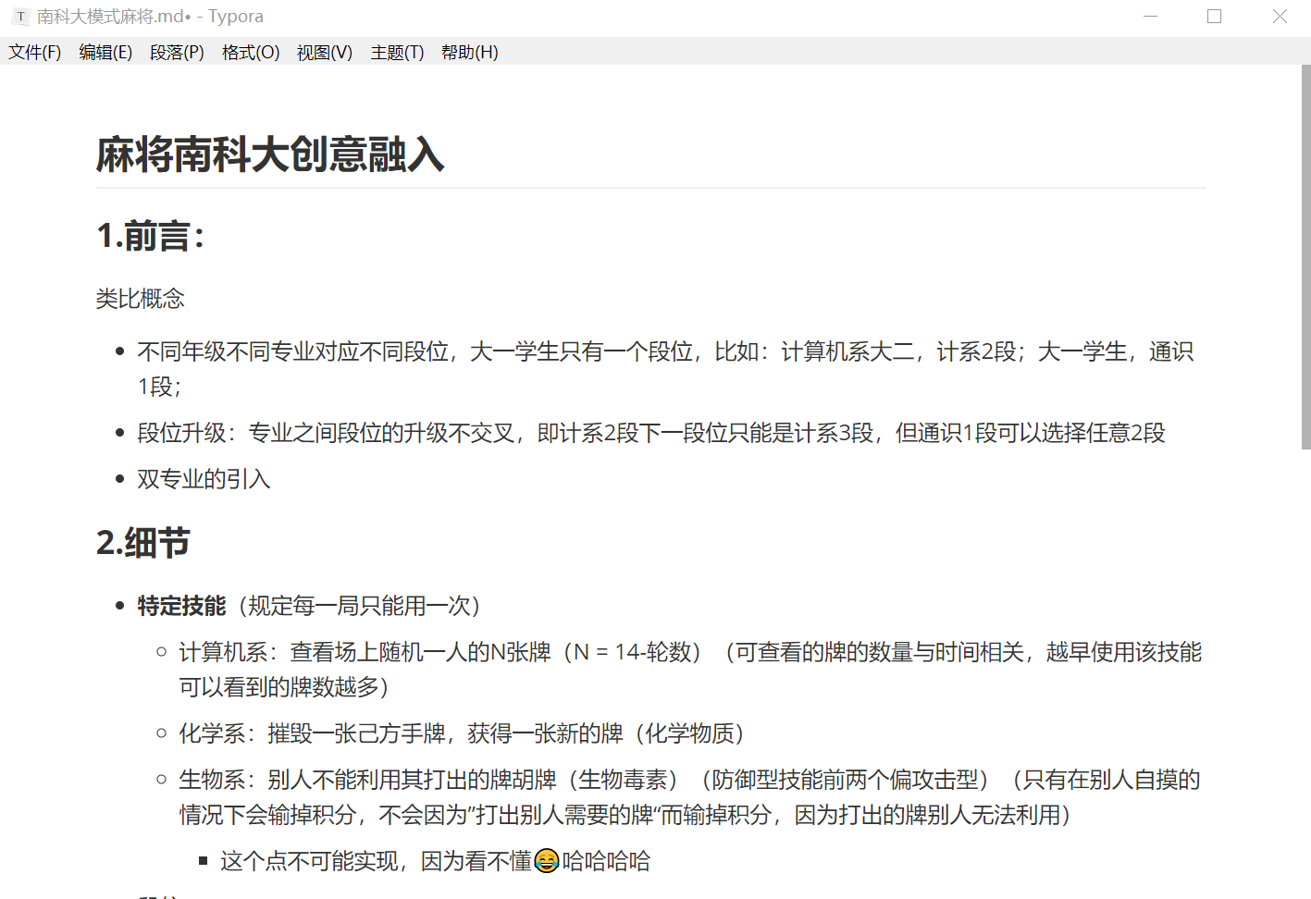
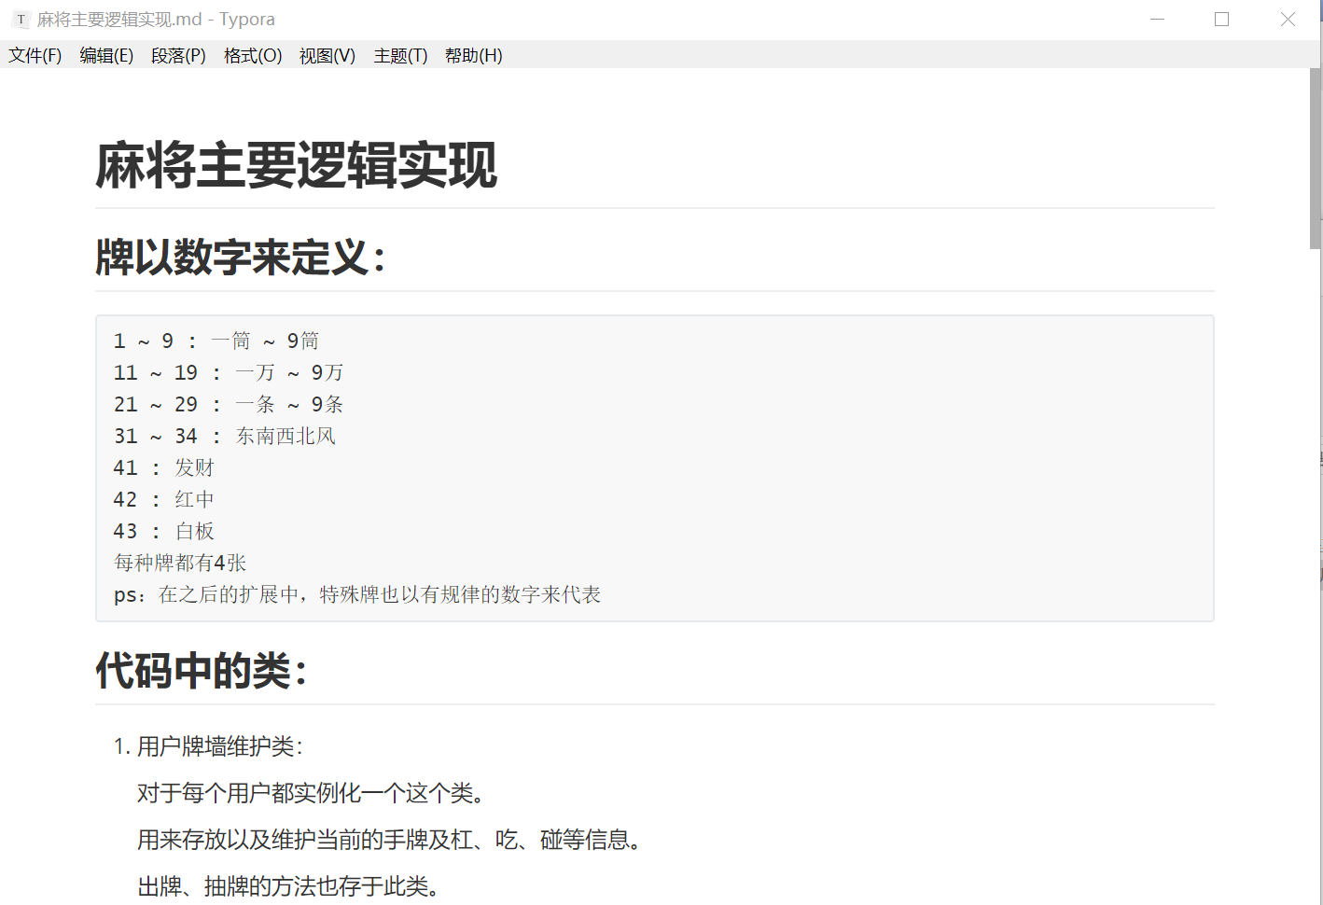
We also write lots of documents as we develop

Slide 22
Each team member’s responsibility
Design the rules of the game
Provide art and music resource
林傲
Help implement the code
Help write documents based on code
Prepare for the Pre
向昕昊
卞证
Implement the code
徐天元
孙斌贤
Solve technical problems
Help Implement the code
Write these documents based on code
Help Implement the code

Slide 23
Next step:
Combine the PVP mode and PVE mode
Focus on better UI
Combine with more arts and music materials
Add more design pattern
Prepare for the final presentation!

Slide 24

THANK YOU
卞证 向昕昊 徐天元 林傲 孙斌贤

